Slide 1
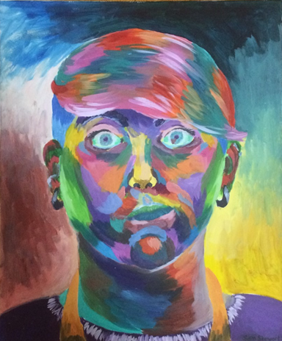
Self
Portraits
Self Portrait, 2014
Notes:
There is a lot of artwork that consists of self portraits
Why do people make self portraits?
In what ways can we do this?
Does it have to be a literal representation of ourselves?

Slide 2
1.
Traditional Self Portraits
Notes:
Start with the traditional ones
So old paintings people did of themselves

Slide 3
Why did people traditionally make self portraits?
Notes:
This is before the photograph was invented:
To show their jobs
Storytelling
Mortality
Mirrors – lots of that
Self promotion
For fun – adding themselves into a bigger painting

Slide 4
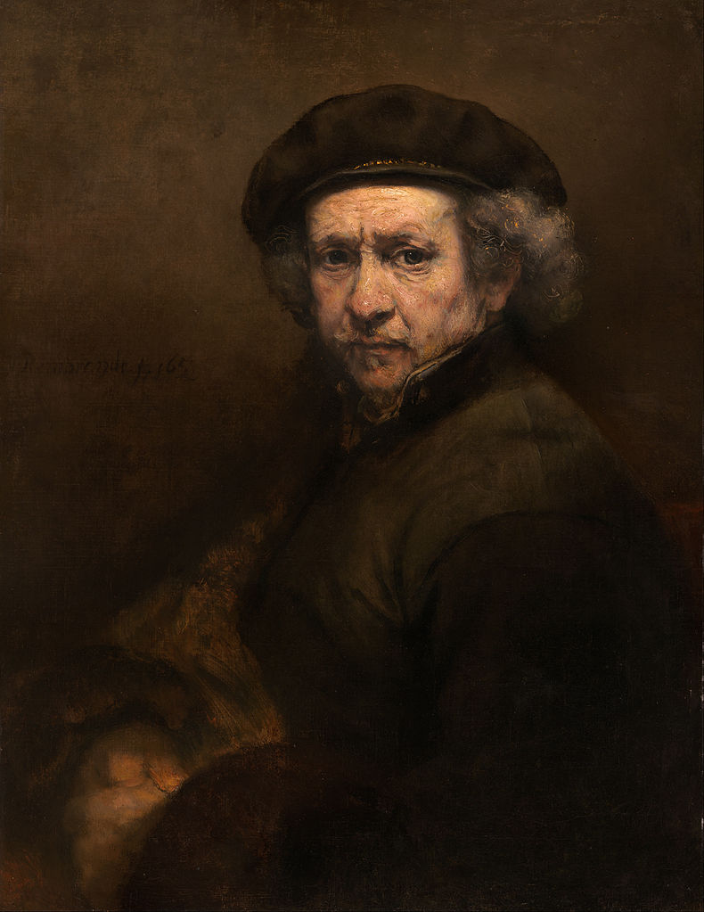
Immortality:
Rembrandt
Self-Portrait with Beret and Turned-Up Collar, 1659
Notes:
Everyone wants to be remembered, and this was also the case way back
We still do this today – much more with photographs though
Looking at this one – in his good clothes – posed – as if someone else was painting it

Slide 5
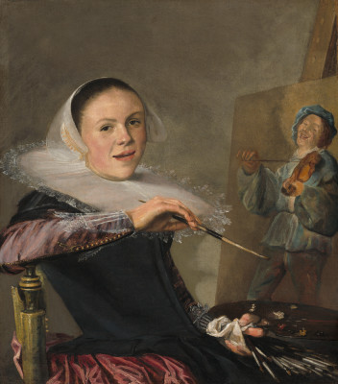
To Depict Their Job:
Judith Leyster
Self Portrait, 1633
Notes:
Show what they did
Had to decide on what to paint themselves in – their good clothes or their actual painting clothes
Self promotion

Slide 6
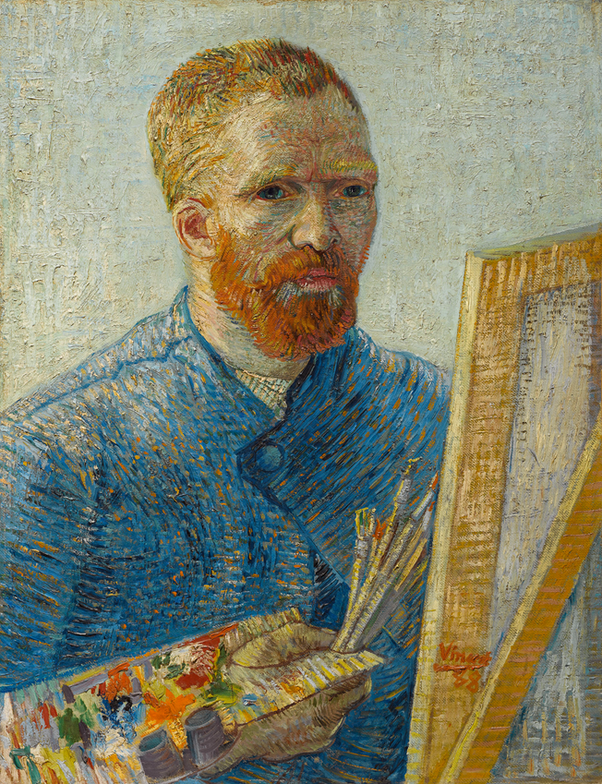
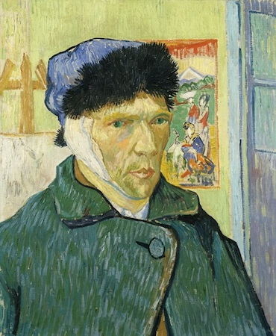
Its Subject Matter That is Always There:
Vincent Van Gogh
Self Portrait with Bandaged Ear, 1889
Self Portrait as a Painter, 1887-88
Notes:
Obviously you always have yourself with you, so it is something you can depict over and over
Van Gogh did a lot of self portraits – even did like 43 between 1885 and 1889

Slide 7
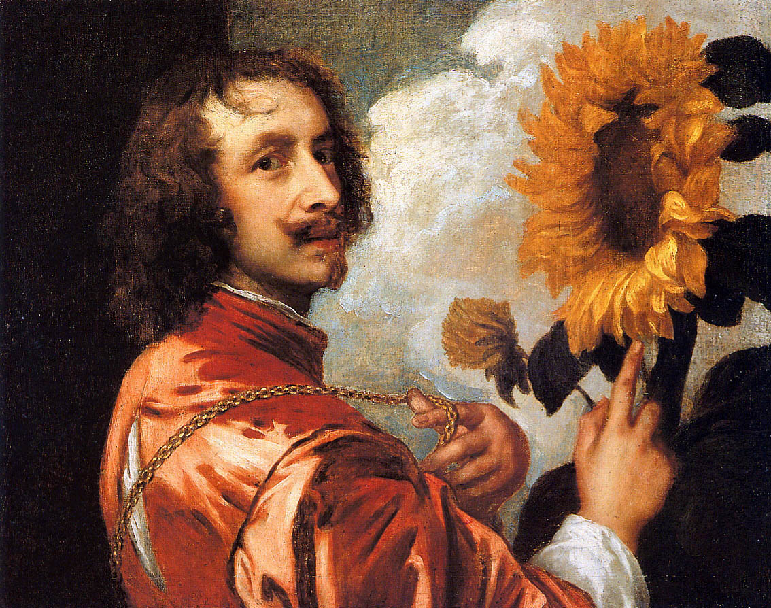
Storytelling:
Anthony van Dyke
Self Portrait with a Sunflower, 1632
Notes:
Sometimes depicted themselves in a fictional story
Fantasy and role playing
Charles I of England, who was his employer, he wears his chain in this – the flower symbolizes his patronage to the king
Not a real scene to depict

Slide 8
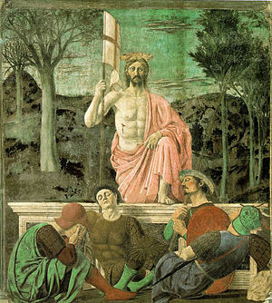
For Fun:
Piero della Francesca
The Resurrection: 1460s.
Notes:
Sometimes artists insert themselves into artworks they made
In this piece, the artist actually depicts himself as a sleeping soldier
Perhaps there is a deeper meaning, but we do not know for sure

Slide 9
How Photography Changed Self Portraits
Notes:
Photography – obviously changed this because we could take pictures of ourselves – didn’t have to do long paintings
1800s – It was invented
By the 1900s, the Kodiak brownie camera was invented where anyone could get one (although they were marketed to girls), so now self portraits became even more common
Selfies started – where it is a self portrait but not really posed – more a snapshot in time – flattering, meant for social media
Sometimes to capture what else is going on

Slide 10
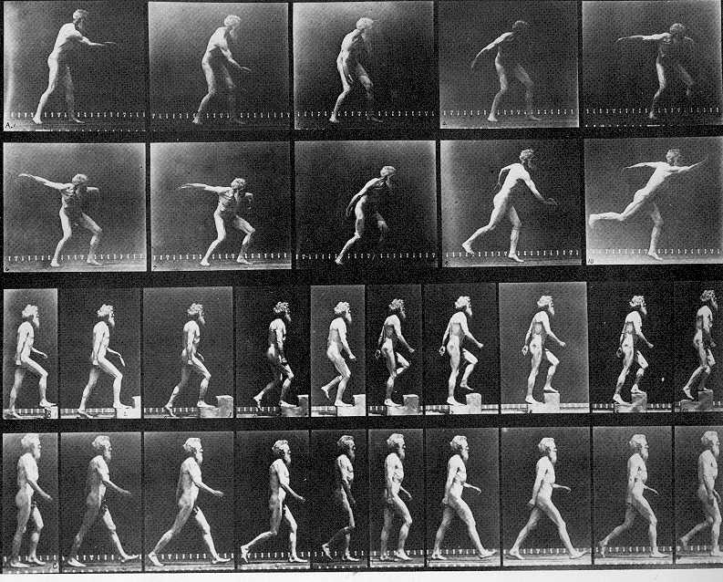
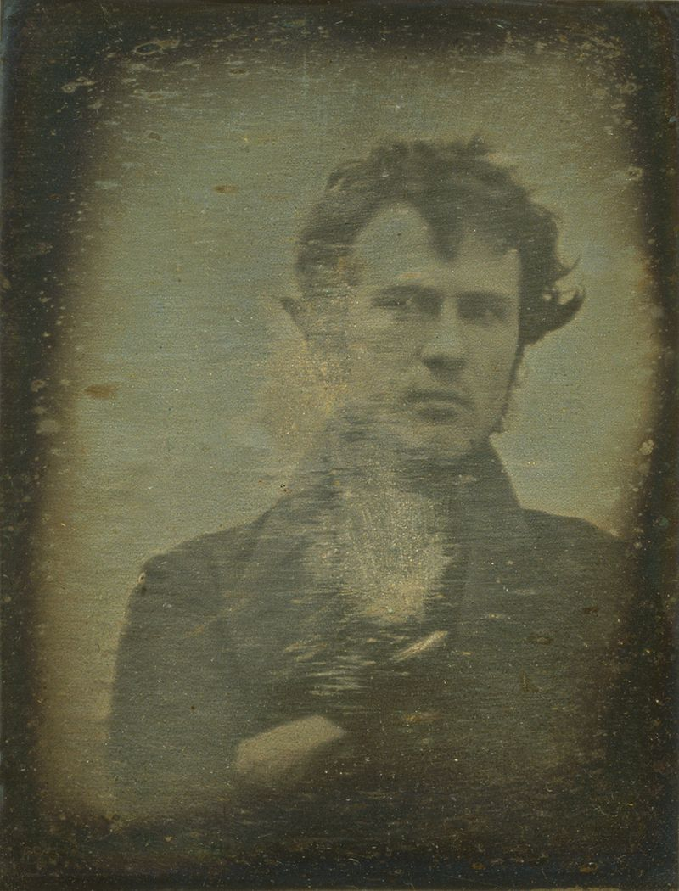
Eadweard Muybridge, Self Portrait as man throwing, climbing, and walking, 1893
Robert Cornelius, Self Portrait, 1839
Notes:
Muybridge – was working on how figures moved – took lots of pictures of them, including himself
Cornelius – one of the pioneers of photography – the back of this picture says – “The first light picture ever taken” – and it was a self portrait
So obviously this opened a lot of doors for people, but also forced non-photographers to do different stuff with portraits

Slide 11
Drawing : Realistic Self Portrait
Notes:
First assignment – you gotta draw a realistic self portrait of yourself
Go over assignment sheet

Slide 12
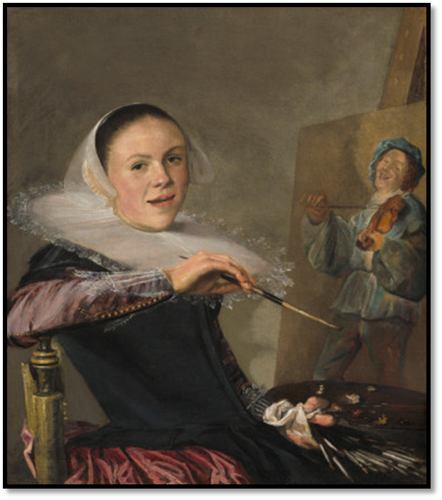
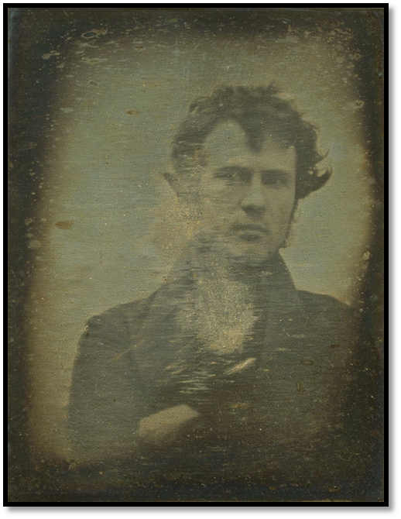
Recap
Robert Cornelius, Self Portrait, 1839
Judith Leyster, Self Portrait, 1633
Notes:
There were a lot of reasons artists traditionally made self portraits – i.e. show their job, for fun
Photography came and changed all of this – made it very easy to do
People have to do different things when it comes to non-photography self portraits

Slide 13
2.
After Photography
Notes:
Now we are looking at self portraits that came around after photography

Slide 14
Hyperrealism
Notes:
Genre of art that resembles high resolution photography
Developed since the 1970s in the United States and Europe
Hyperrealistic artists use photos as references
Very similar to Photorealism

Slide 15
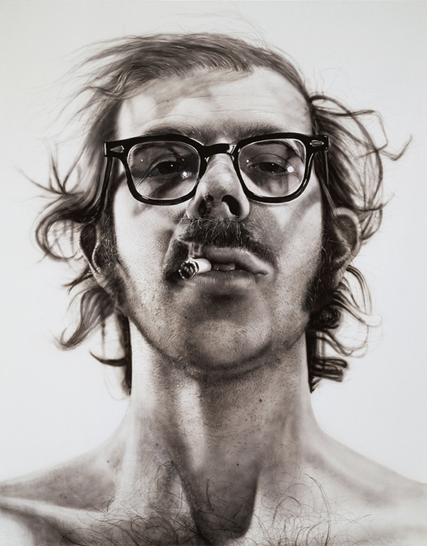
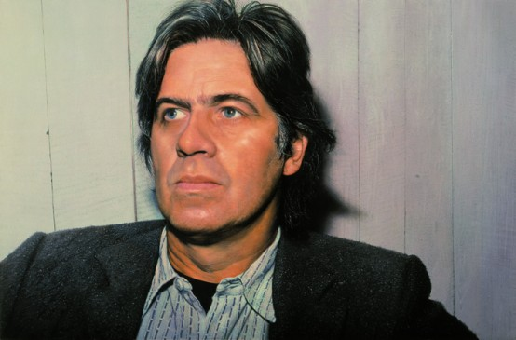
Franz Gertsch, Self Portrait, 1980
Chuck Close, Self Portrait, 1968
Notes:
Franz Gertsch:
- Swiss painter – known for these
Chuck Close:
American painter/artist and photographer who achieved fame as a photorealist, through his massive-scale portraits
catastrophic spinal artery collapse in 1988 left him severely paralyzed
After this he makes works through circles of colour which give a similar effect to his earlier work
Very concerned with portraits of people
Both work very big

Slide 16
Moving Away From Realism: Using Symbols
Notes:
Artists started depicting themselves in different styles
Using different symbols that they think represent themselves

Slide 17
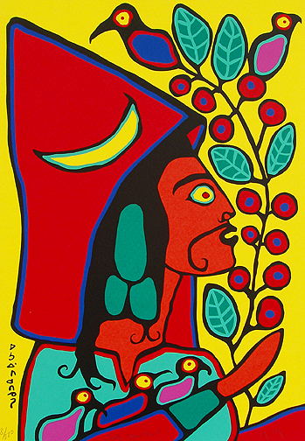
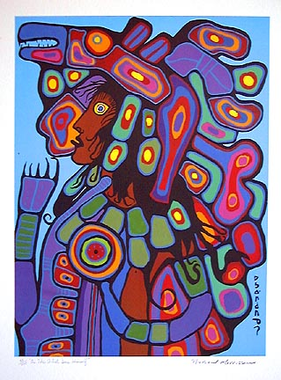
Norval Morriseau
Self Portrait, 2005
As The Artist Sees Himself, 1992
He includes different symbols of what he believes represents himself.
Notes:
Norval Morriseau:
Works in the woodland style
Hard life – went to residential school, ended up meeting an artist and learning about art
Went to jail, continued to paint
In his work, he often depicts himself as how he sees himself – look at all the animals he uses, and why. The colours may also depict something

Slide 18
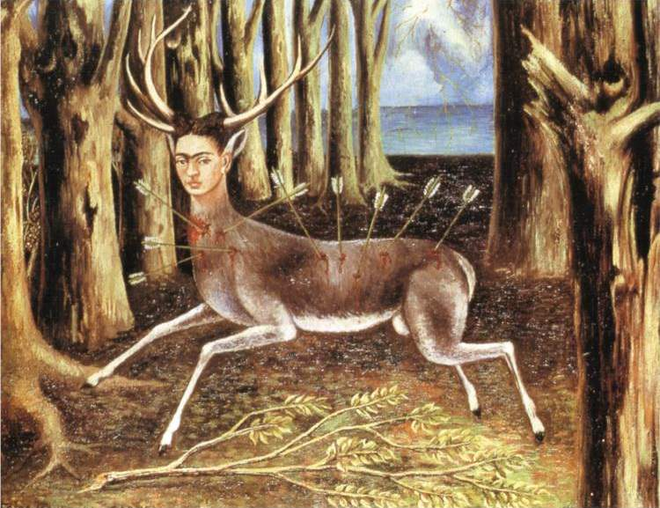
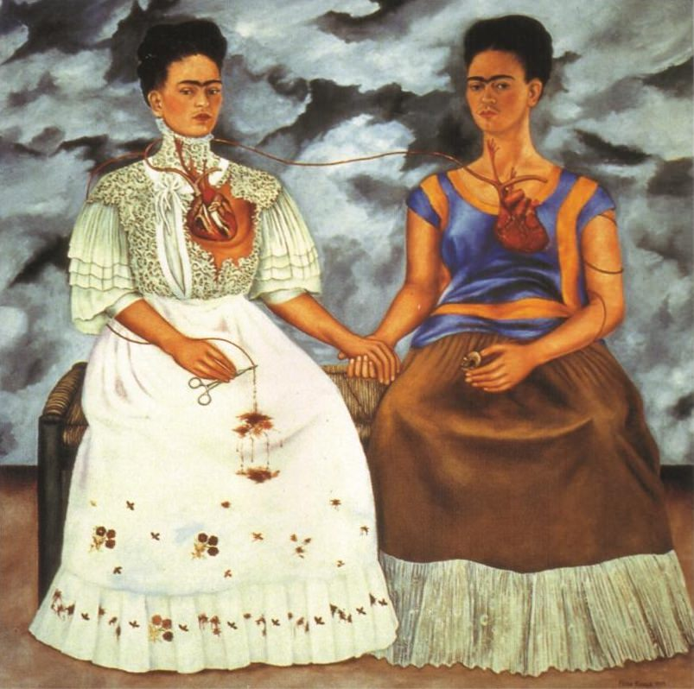
Frida Kahlo
The Two Fridas, 1939
The Wounded Deer, 1946
Includes a lot of symbolism, even fragmenting her original form.
Notes:
Friday Kahlo:
Mexican painter
Even though she was married to a man, she continued to engage in relationships with women: Bisexual
Accident in her younger years (bus) caused her pain throughout her whole life
The accident had her “ begin again, painting things just as I saw them with my own eyes and nothing more”
Did a lot of self portraits – looking at these – using different symbols to show how she thought about herself

Slide 19
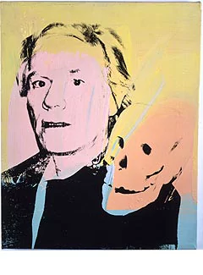
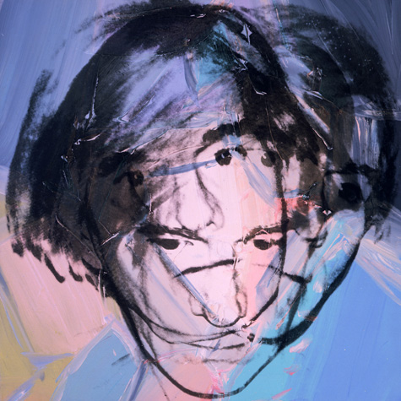
Andy Warhol
Self Portrait, 1978
Self Portrait with Skull, 1978
Notes:
Andy Warhol:
Known for his pop art
Gay artist – often worked with LGBT people
Looking at these, you can see how his style came out in his self portraits – what about the poses? The object?
Colours? More abstract – focusing on line

Slide 20
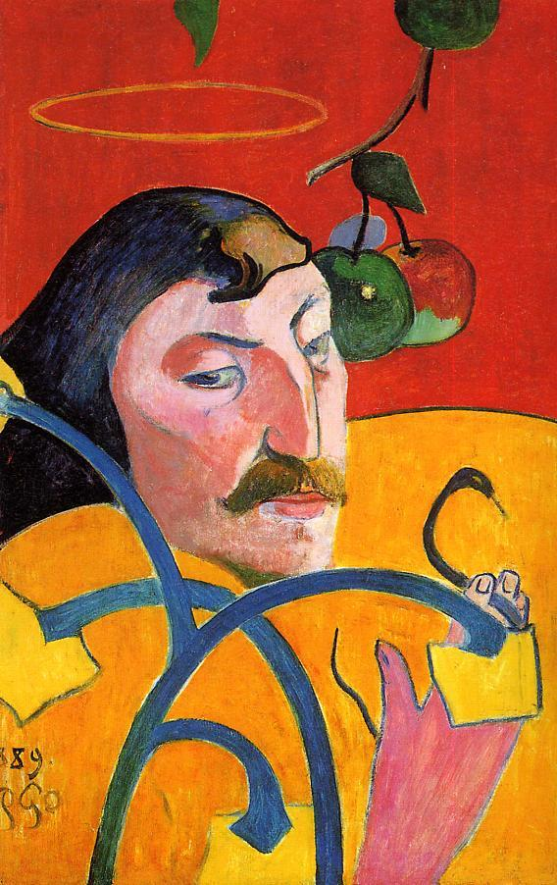
Discussion: What Does this Self Portrait Mean?
Paul Gauguin: Self Portrait with Halo and Snake, 1889
Notes:
French post-impressionist artist
Important in the symbolist movement
Discussion: turn to your group, discuss what you think the symbols in the self portrait could mean
Do a list on the board – discuss
Ex: halo/apples/snake: god-like? Saint? Adam and eve!
Divided the red and yellow – saint and sinner?
Cariciature?

Slide 21
Other New Ways to Depict
Notes:
-Other ways than using symbols

Slide 22
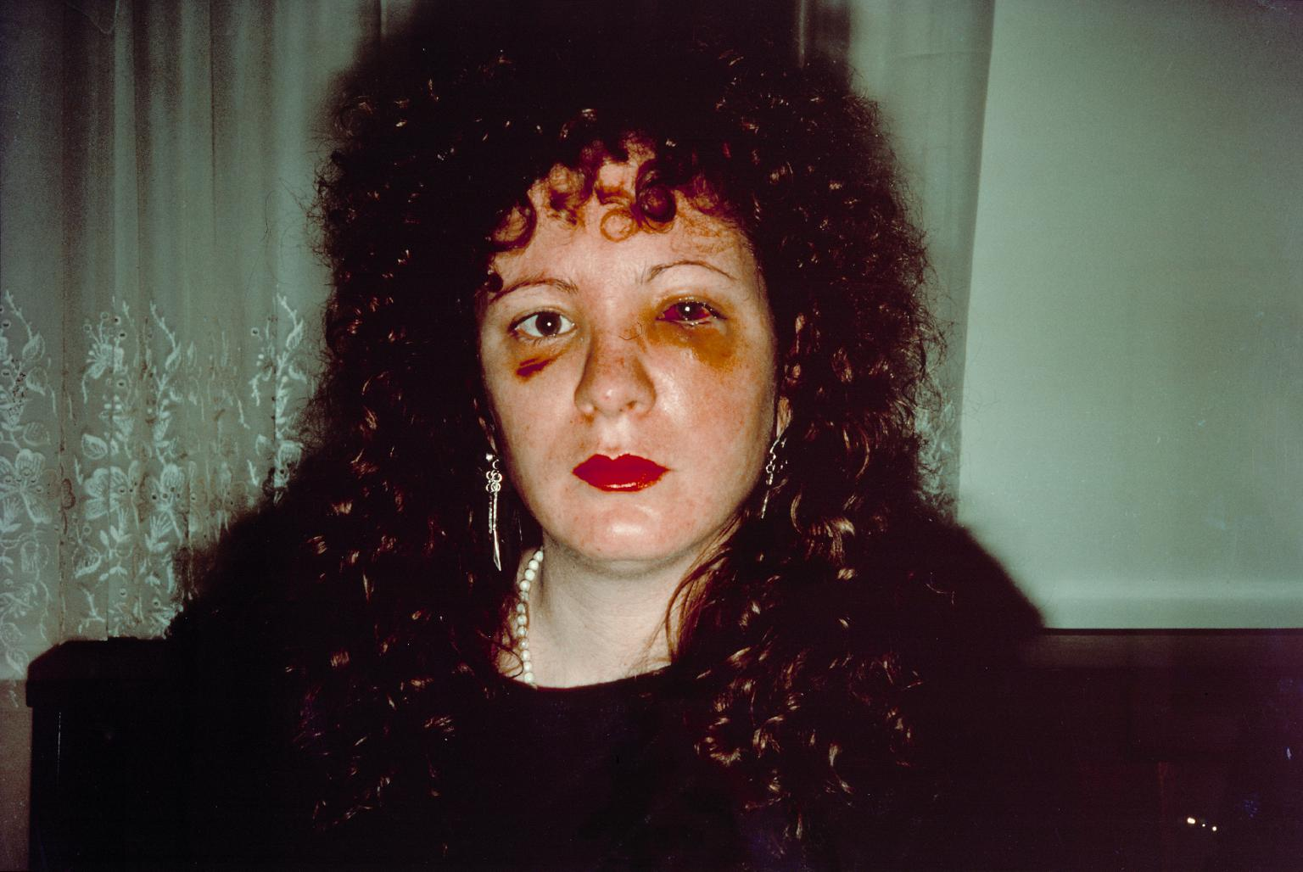
Nan Goldin
Depicts herself in an unflattering way.
Nan One Month After Being Battered, 1984
Notes:
Start seeing self portraits in non-flattering lights – not as posed as we are used to
Nan Goldin – American photographer – very personal subjects – relationships – close with LGBT part of NY
Showing herself as being battered – interesting – also interesting title, not self-portrait – as if she was a different person

Slide 23
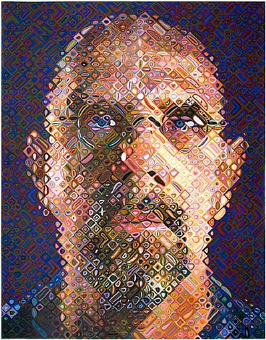
Chuck Close
Due to an accident, Close now paints his portraits in spots of colour
Self Portrait, 2007
Notes:
Chuck close, the hyperrealist painter, after his spinal injury
Started doing portraits in a colour block style
You can tell it is a self portrait, but it is interesting because it is so fragmented and so different from what else he did

Slide 24
Collage: Create a Symbolic Self Portrait

Slide 25
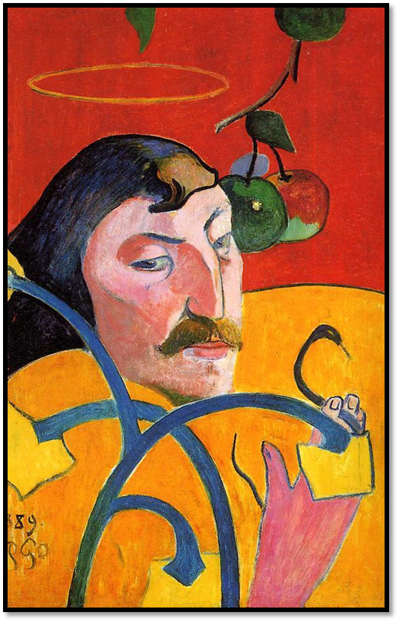
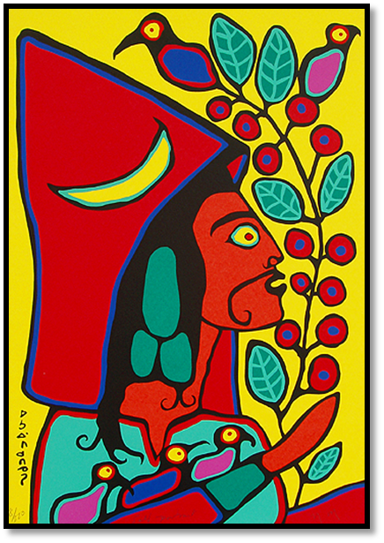
Recap
Norval Morriseau, Self Portrait, 2005
Paul Gauguin: Self Portrait with Halo and Snake, 1889
Notes:
We talked about how after photography, self portraits changed to using lots of symbolism, or started to do different techniques
We discussed this image of Paul Gauguin and how he used symbols to portray his personality

Slide 26
3.
Self Portrait?
Notes:
What is a self portrait?
We are going to look at artworks that stretch our idea of self portrait
Some include artworks that the artist uses themselves in but doesn’t call it a self portrait
Or, they are artworks called self portraits, but they aren’t there fully

Slide 27
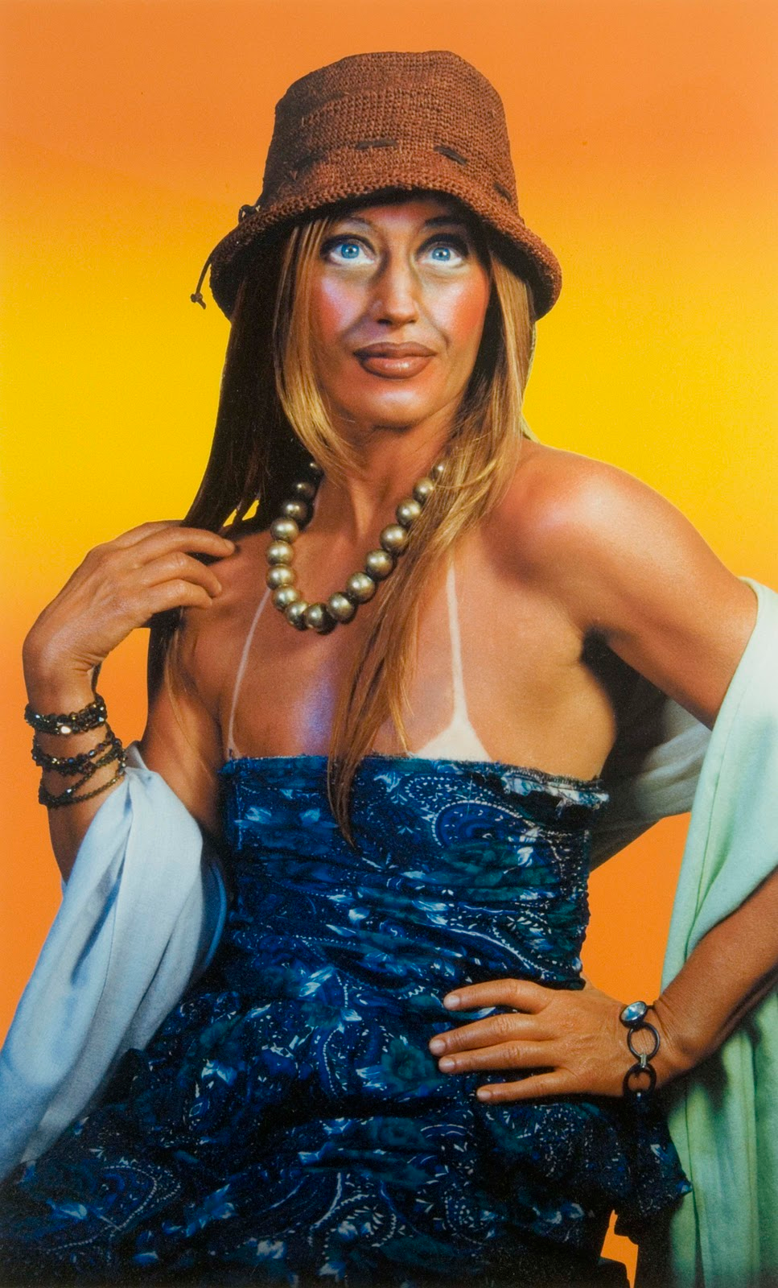
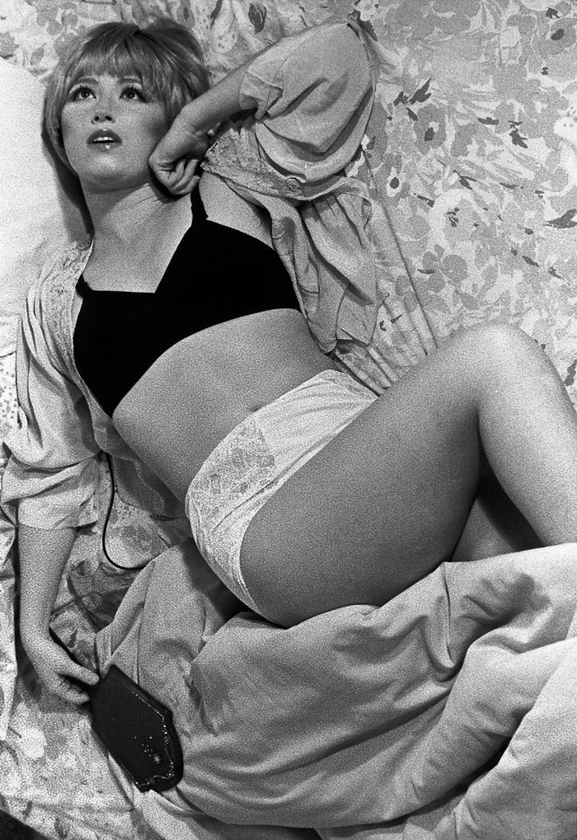
Cindy Sherman
Woman in Sundress, 2003
Untitled Film Still #06, 1977
Dresses up as different characters and photographs herself.
Notes:
American photographer
Famous for her photographs – she is always the subject in her photograph, but she dresses up as someone else
Is it still a self portrait if you are pretending to be someone else?

Slide 28
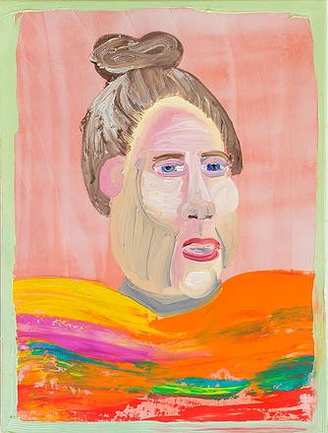
Amber Boardman
A future portrait
Middle Aged Selfie Hand Knitted Sweater, unknown
Notes:
American painter
Uses a very painterly style – often depicts things in a way children would – simplified and gross
Is this a self portrait? If it is depicting you in the future?

Slide 29
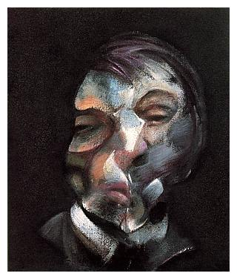
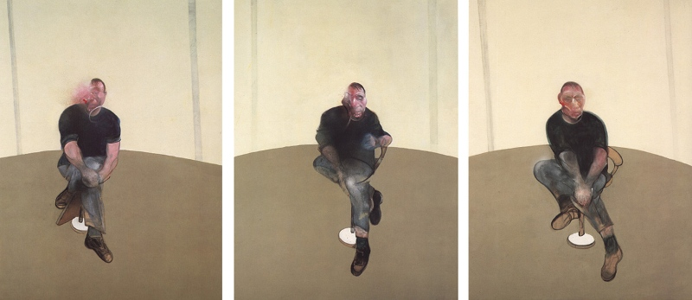
Francis Bacon
Fragmenting themselves to unrecognizable
Self Portrait, 1971
Study for Self Portrait – Triptych, 1985-86
Notes:
Francis Bacon – British painter
Known for abstracting figures and his odd imagery
A queer artist – known for his relationship with George Dyer: allegedly through a burglary in the artists home
Both experienced alcoholism and Dyer ended up overdosing
Although, this may not be a new idea, we didn’t talk about it yet
When you cannot recognize the figure anymore, is it really self portrait?

Slide 30
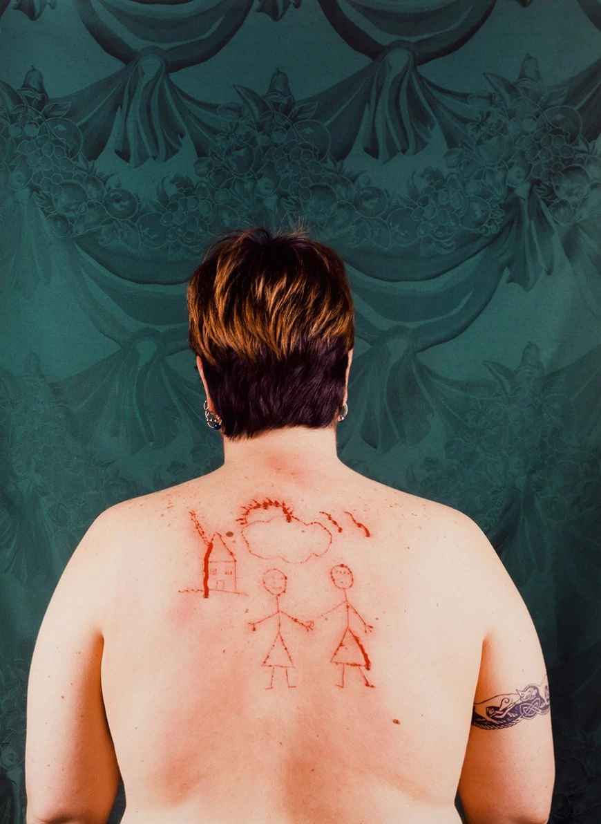
Catherine Opie
Very emotional work, not showing the artists face
Self Portrait/Cutting, 1993
Notes:
American photographer
Queer artist – often shows queer people, her friends – playing with gender roles
In this work, she has cut her own back (or someone else) and it depict two women holding hands
She has titled it: Self portrait, but we do not see her face. Is it still a self portrait?

Slide 31
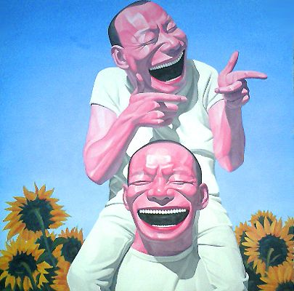
Yue Minjun
He is each painting with a huge smile
Sunflowers, 2003
Notes:
Chinese contemporary artist
shows himself in a frozen laughter state in each painting
At a glance, you think the figure is laughing, but once you look more, is he really?
Often has red skin in them
Is it a self portrait?

Slide 32
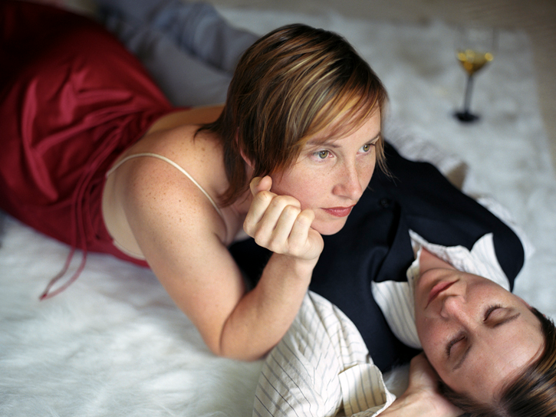
Kelli Connell
Photographs herself in every photo but doubles herself
Reverie, 2005-2006
Notes:
American photographer
Photographs herself and doubles it
Thinks about gender roles – often showing herself in a relationship with herself. and other issues
Very interesting to look at
Is it a self portrait?

Slide 33
Painting: Create Your Own Inner Self, Self-Portrait

