Slide 1
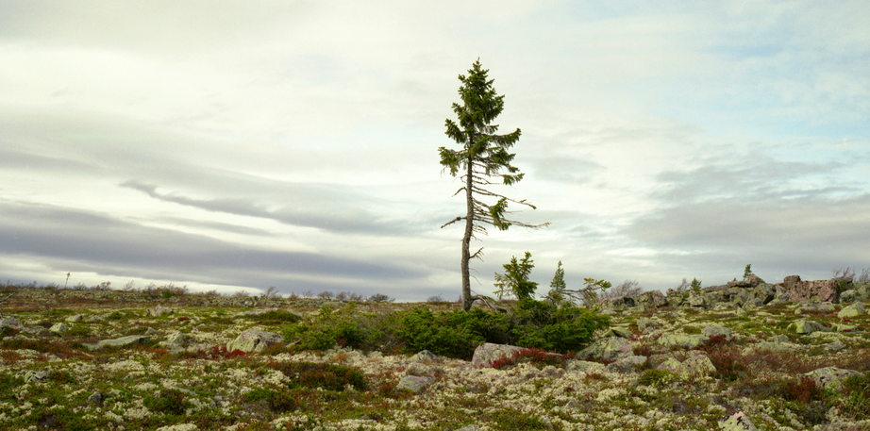
Environmentalism and
Art Education
By: Samantha Stewart
Excerpt from Rachel Sussman’s series The Oldest Living Things in the World
Notes:
- Why I chose – I have always loved environmental stuff, I often make eco-art
recorded the oldest living things in the world

Slide 2
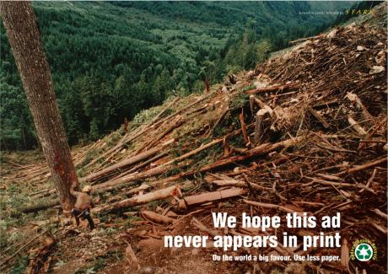
Environmentalism
Concern about and action aimed at protecting the environment
Notes:
Important to everyone seeing as we have to live on this earth
We need to instill this in our kids because they will come up with ways to fix things – as well as to not make the problem worse
Ads – use of visual art against this already

Slide 3

Shades of Green:
Growing Environmentalism through Art Education
“Eco-art education integrates art education with environmental education as a means of developing awareness of and engagement with concepts such as interdependence, biodiversity, conservation, restoration, and sustainability.” – H. Inwood
Notes:
- I know it focused on elementary school teachers but I found the things they did went with our curriculum too
Key points to come out of the reading – the four teachers working – didn’t have a background in it – went with it anyway – started a lighter shade of green
4 main ways

Slide 4

Model the 3Rs (Reduce, Reuse, Recycle)
Waste Reduction
  Handout
And Repurpose! (Found Materials)
  Objects in nature, but also second hand items

Slide 5
Sustainable Art Practices
Acrylic Paint
Use reusable pallets (rather than throwing out pallets each time they are used)
  Even better if you have lids for your pallets so that the kids do not have to wrap it in plastic wrap to save the paint
Mix paint with pallet knives rather than brushes in order to not waste paint
Eternal painting by the sink for students to put their extra paint on
Teach your students to wash their brushes correctly!
Use old plastic containers to hold water
Wipe off extra paint on brushes before washing
Oil Paint
Use walnut oil or another eco-friendly brush cleaner
Use natural oils (linseed, walnut, etc.) to thin paint
Clay
extra bin for sediment – reuse once you are done
Reusable table coverings (fabric or parachute material)
Sculpture
Value Village and Goodwill for sculpture materials, etc.
Use scraps that would have went into the garbage anyway (cardboard, Styrofoam pieces)
General
When you can, buy eco-friendly brands of products (soap, and cleaning products)
Buy non-toxic materials as they are safer to use and safer for the environment
But if you do have toxic materials, make sure you dispose of them properly
Go digital when you can to reduce paper usage (ex. Send students handouts online)
Use old clothes as rags
Buy recycled paper or anything else you can get recycled
Don’t clean with turpentine!

Slide 6
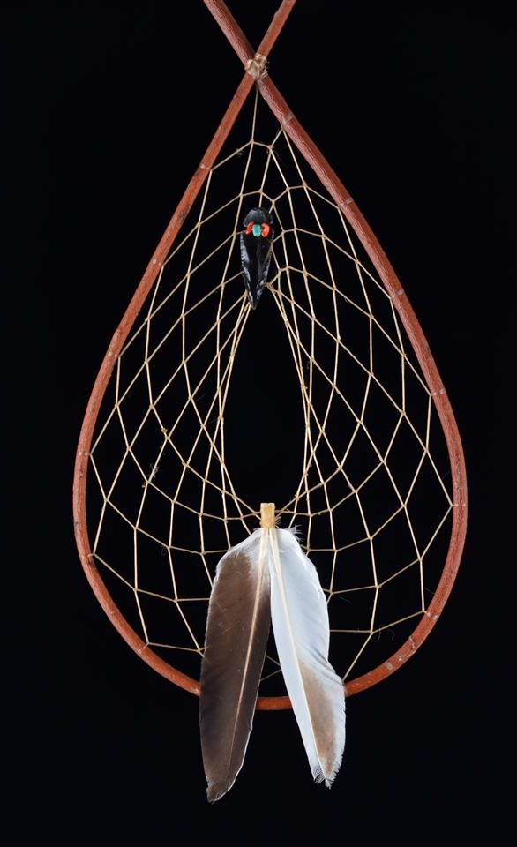
Sustainable Approaches to Making Art
Biodegradable materials
  Such as snow art, ice art, natural materials woven into fences, etc.
Natural processes
  Many FNMI art forms were made with natural objects
  Using plants – Fairy Garden

Slide 7
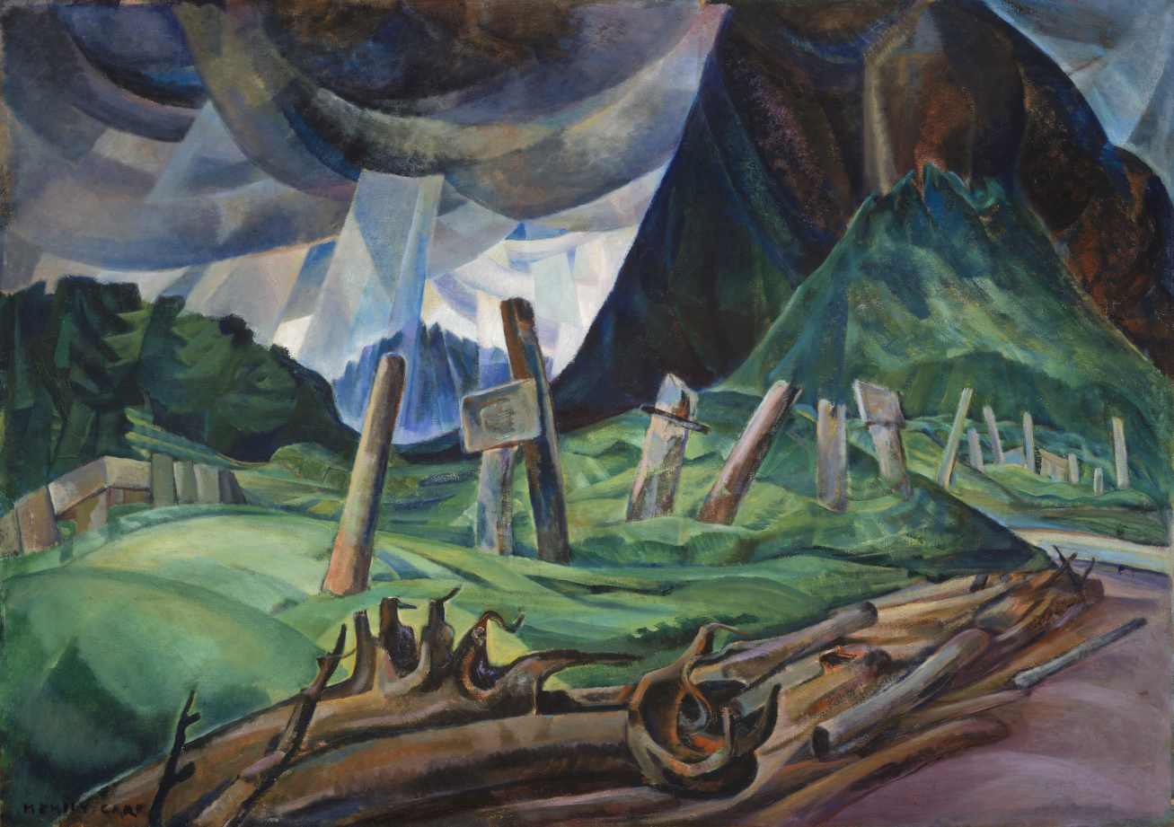
Emphasizing Environmental Content of the Work
Emily Carr – Vanquished (1930)

Slide 8
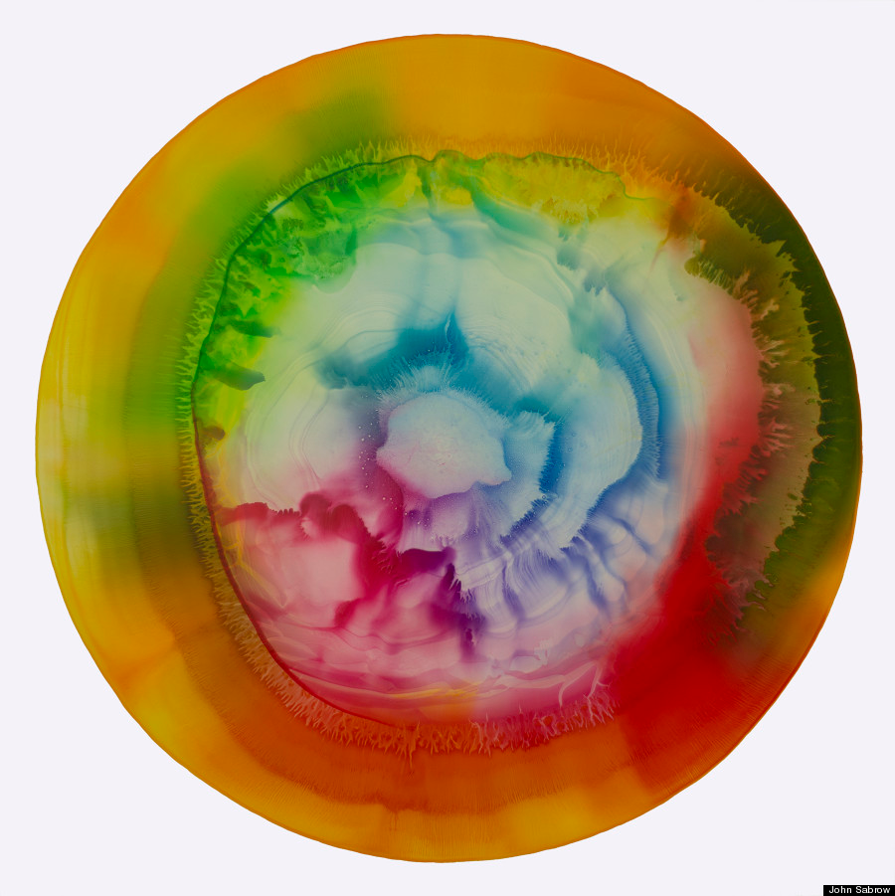
Resources
Women Eco Artists Dialogue: http://weadartists.org/
Meet The Greens: http://www.meetthegreens.org/
13 Artists Working on Climate Change: http://www.huffingtonpost.com/2014/07/15/environmental-art_n_5585288.html
John Sawbrick –Toxic Art
Notes:
Lots of female artists working with eco content
A website more intended for ages 9-12, but really interesting stuff like a carbon calculator
Some amazing artists working with this content
Toxic flow of iron oxide from old mines that arent properly sealed – working to clean these streams – using to make art

Slide 9
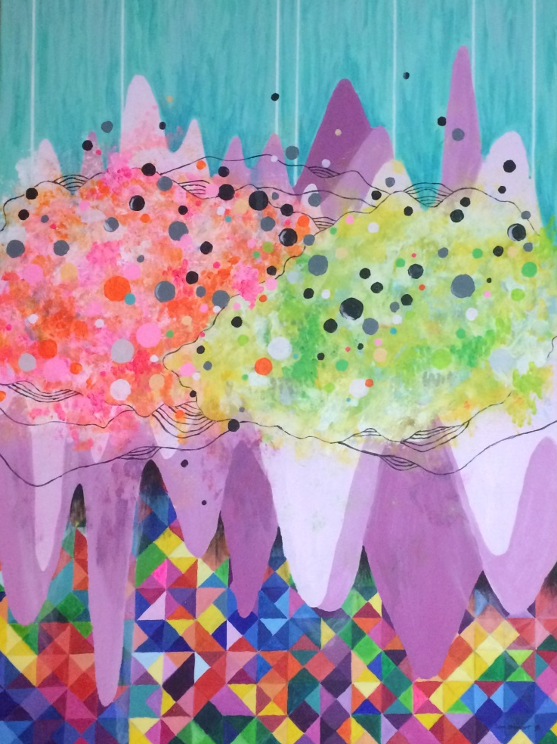
Discussions About Art
What are some issues you could bring awareness for students in eco-art lessons? How could you?
The article explains that eco art is “to teach students about art in a way that promotes an understanding of the interdependence and interconnectedness of all things”. Do you think this is true or false? Why?
Have you ever created eco-art?
Notes:
-they say have a conversation with your students so we are going to have a conversation now
- Issues: climate change, deforestation, overfishing, garbage in landfills, and wasted food, animal agriculture

Slide 10
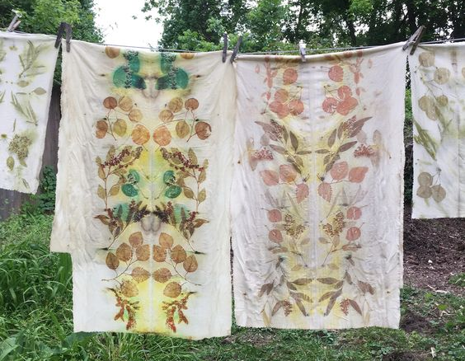
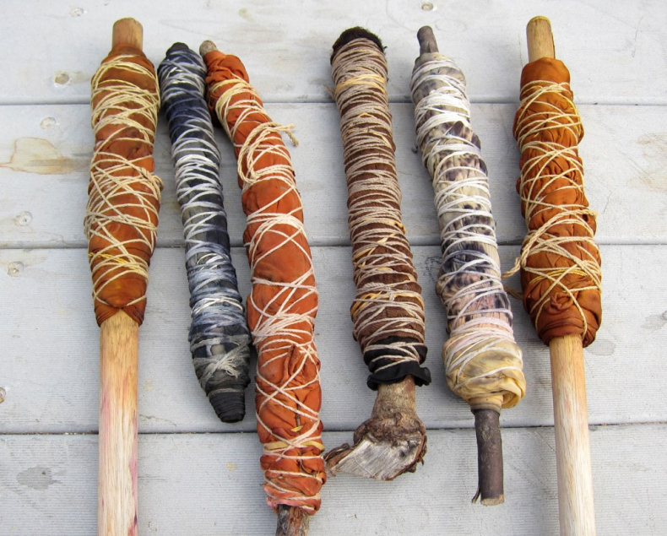
Eco Printing on Fabric Lesson
Notes:
I couldn’t find a formal lesson plan for this, but I found a tutorial online on how to do it which you could easily adapt for your own needs
printmaking!
Explain it
Why it is exemplary – because it uses a technique students would probably never have used, while using found objects that you as a class could gather. It allows them an opportunities to find different plants they have never seen and learn their names
Fabric arts also seen as feminine – good to get boys involved in them
as well as a surprise element because you do not know how it will turn out

Slide 11
Links to the Ontario Curriculum (AVI3M)
http://www.frankie.com.au/blogs/craft/5206-frankie-exclusive-diy-an-introduction-to-eco-dyeing
A1. The Creative Process
A2: The Elements and Principles of Design
A3: Production and Presentation
C2. Conventions and Techniques
C3. Responsible Practices

