Slide 1
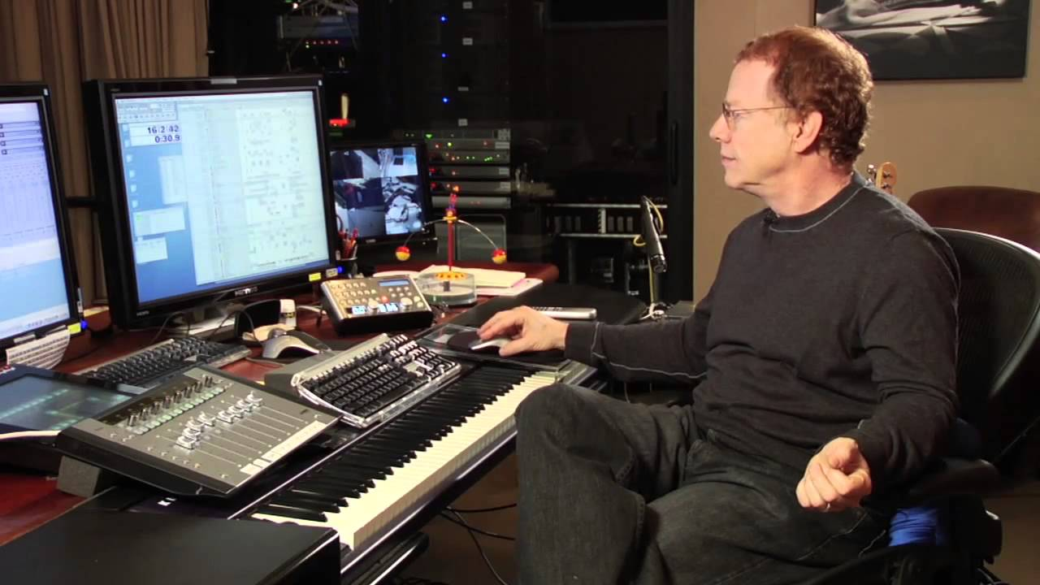
Careers in Film Music

Slide 2
Careers Opportunities
Write the Music: Music Supervisor, Composer, Orchestrator, Copyist, Arranger
Play the Music: Musicians, Conductor
Edit the Music: Recording Engineer, Editor
Sound Effects: Sound Design

Slide 3

Create The Music

Slide 4

Music Supervisor
Supervise all of the music in the film
Meet the needs of the Director/Producers
Makes selections for a compilation score and gets copyright approvals (for found music)
Has to make negotiations about finances
What do I do?

Slide 5
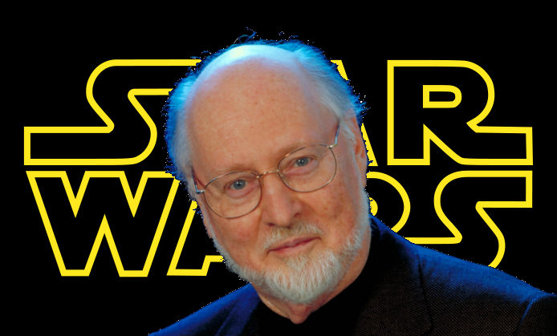
The Composer
Compose the music!
Most composers are brought in after the film has been shot or while the film is being shot
Meets with Director and Producers
Spotting sessions
Writes!
Gives to arranger and copyist to give to the musicians
Have short period of time to write!
What do I do?
Notes:
Must agree as to what they want
Watches parts of movie and learns what needs to be there Start with spotting - watching rough cut and deciding which spots need music - can be done by composer, music editor and/or director
Film music usually covers half of a movie
Until 1937, when a film score won an Oscar, it was accepted by the head of the studio’s music department instead of the composer

Slide 6
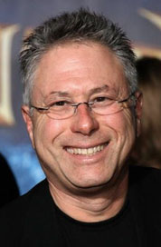
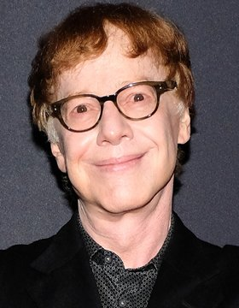

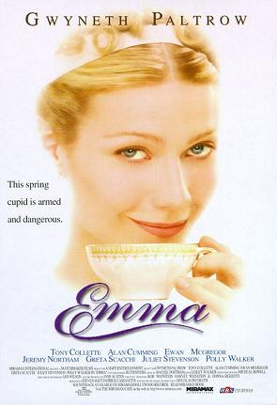



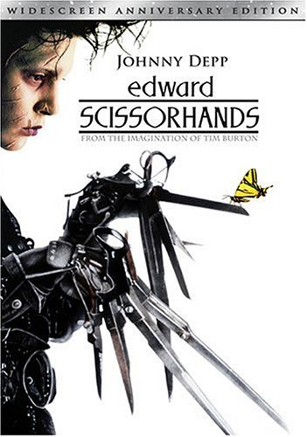
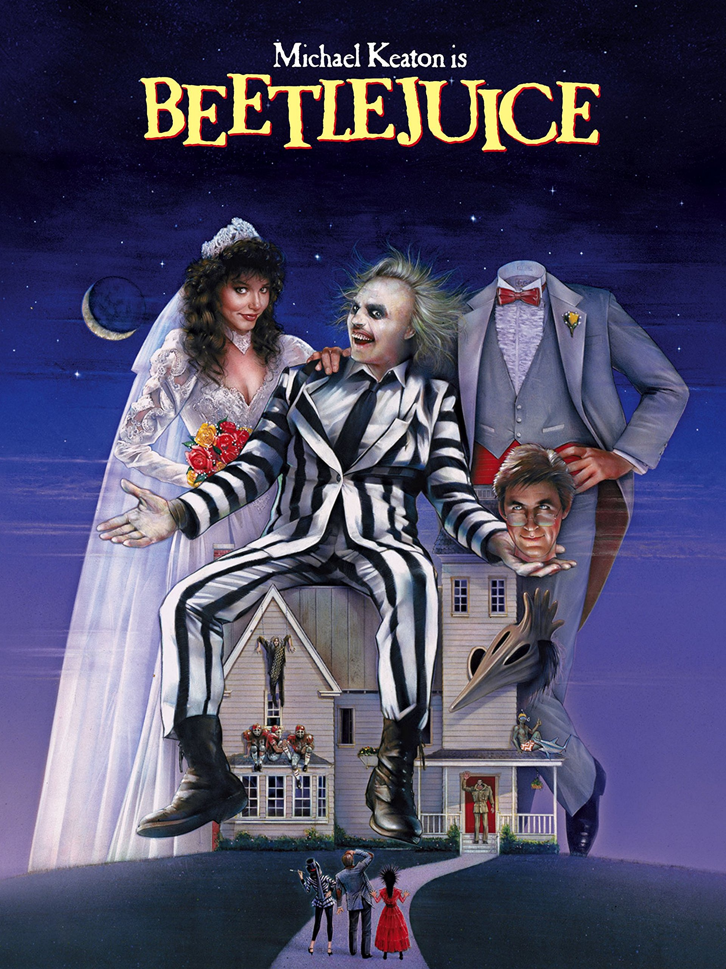
Examples
Rachel Portman
Alan Menken
Danny Elfman

Slide 7
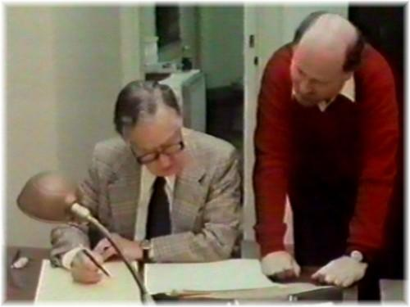
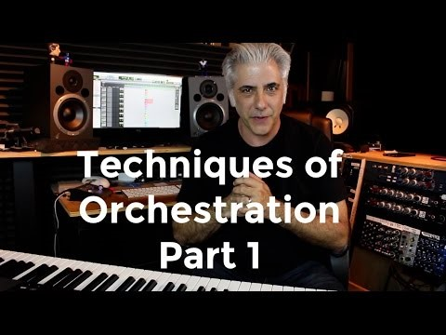
The Orchestrator
Transpose music and write scores based off a composer’s initial draft or sketch
Very important – tight timeline
Often the arranger (can be another job)
What do I do?
Notes:
Transposition
Chords – doubling
Who gets what – melody vs harmony
Often not as known or as much credit
Sometimes composers are also orchestrators

Slide 8

Copyist
Creates neat copies of parts from a orchestrator’s score
Also known as score preparation
What do I do?

Slide 9
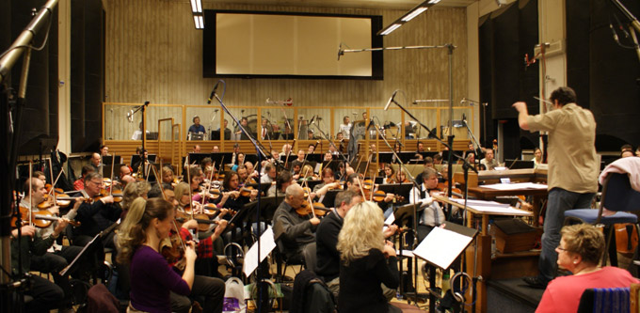
Play The Music

Slide 10
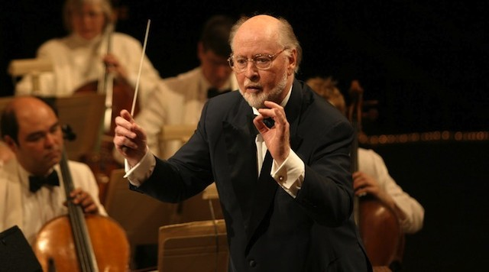
Musicians and Conductor
Freelance or a studio music department
Instrumentation depends on feel
Play the music while being recorded
Often the composer is the conductor
What do I do?
Notes:
Can have a big orchestra – can have a rock band – depends what the composer decided

Slide 11

Edit The Music

Slide 12

Music Editor/Recording Engineer
Mixes and synchronizes the music with the film soundtrack.
Often also oversees the scoring process.
Design a “click track” for the film
Look out for potential problems like a loud cymbal crash occurring at the same time as a line of dialogue
Using software, lay down all the music tracks, fitting them exactly to the picture, ready for the Final Mix or dub.
What do I do?
Notes:
Used to help recording of the song – achieve correct tempo and perfect picture-to-music sync

Slide 13

Sound Effects

Slide 14
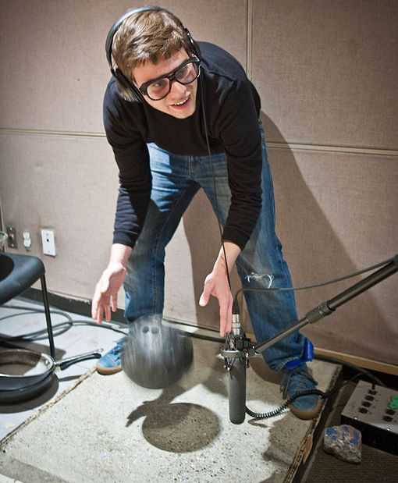
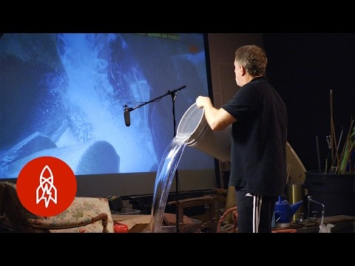
Sound Designer
Create sound tracks for a variety of needs
Sound effects library to work from
Also make their own – Foley artist
Normal film – still have to do, but especially in animated films
What do I do?

Slide 15
Exit Card!
Pretend you have to go into Film Music making. Choose a career that we discussed today and explain why that would be a good fit for you.
Careers:
Write the Music: Music Supervisor, Composer, Orchestrator, Arranger, Copyist
Play the Music: Musicians, Conductor
Edit the Music: Recording Engineer/Editor
Sound Effects: Sound Design

